Slide 1
The Discrete-Time Fourier Transform (ch.5)
Representation of aperiodic signals - Discrete Fourier transform
Fourier transform for periodic signals
Properties of discrete-time Fourier transform
The convolution property
The multiplication property
Duality
Systems characterized by difference equations
Representation of aperiodic signals - Discrete Fourier transform
Fourier transform for periodic signals
Properties of discrete-time Fourier transform
The convolution property
The multiplication property
Duality
Systems characterized by difference equations

Slide 2

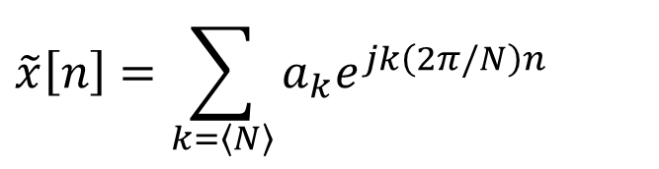
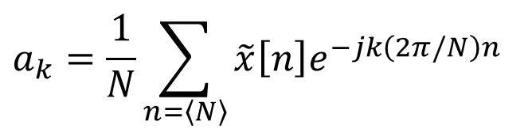
Discrete Fourier Transform
Representation of aperiodic signals
Consider a general sequence of finite duration: $x\left[n\right]=0$ if $n<N_{1}$ or $n>N_{2}$
Periodic extension of $x\left[n\right]$ with $N$
FS representation of $\tilde{x}\left[n\right]$
$$\tilde{x}\left[n\right]=\sum_{k=\left\langle N\right\rangle }{a_{k}e^{jk\left(2π/N\right)n}}$$
$$a_{k}=\frac{1}{N}\sum_{n=\left\langle N\right\rangle }{\tilde{x}\left[n\right]e^{−jk\left(2π/N\right)n}}$$

Slide 3
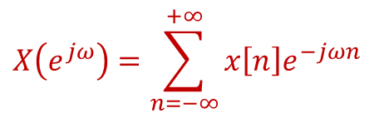
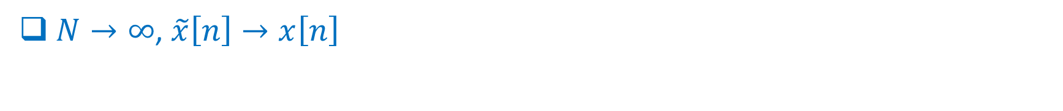
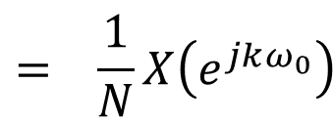
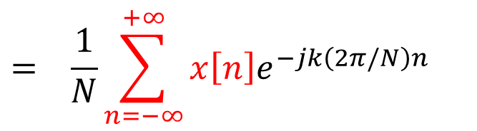
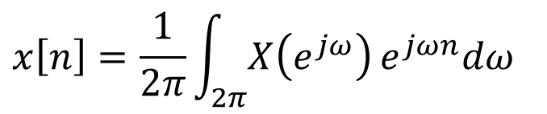
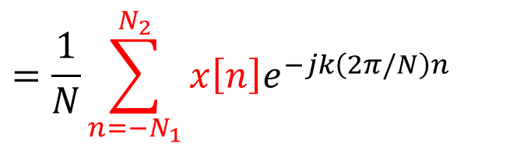
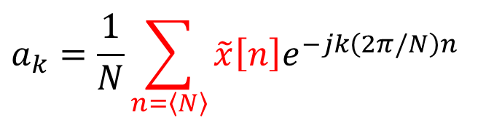
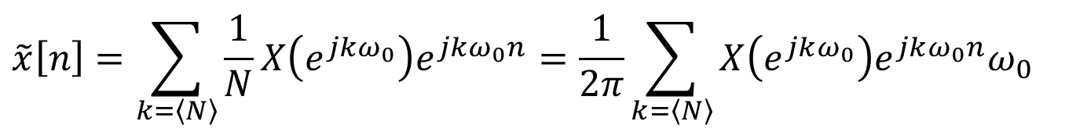
Discrete Fourier Transform
Representation of aperiodic signals
FS coefficients of $\tilde{x}\left[n\right]$
$$a_{k}=\frac{1}{N}\sum_{n=\left\langle N\right\rangle }{\tilde{x}\left[n\right]e^{−jk\left(2π/N\right)n}}$$
$$X\left(e^{jω}\right)=\sum_{n=−∞}^{+∞}{x\left[n\right]e^{−jωn}}$$
Define
$$=\frac{1}{N}\sum_{n=−N_{1}}^{N_{2}}{x\left[n\right]e^{−jk\left(2π/N\right)n}}$$
$$= \frac{1}{N}\sum_{n=−∞}^{+∞}{x\left[n\right]e^{−jk\left(2π/N\right)n}}$$
$$= \frac{1}{N}X\left(e^{jkω_{0}}\right)$$
FS of $\tilde{x}\left[n\right]$
$$\tilde{x}\left[n\right]=\sum_{k=\left\langle N\right\rangle }{\frac{1}{N}X\left(e^{jkω_{0}}\right)e^{jkω_{0}n}}=\frac{1}{2π}\sum_{k=\left\langle N\right\rangle }{X\left(e^{jkω_{0}}\right)e^{jkω_{0}n}ω_{0}}$$
$N→∞$, $\tilde{x}\left[n\right]→x\left[n\right]$
$$x\left[n\right]=\frac{1}{2π}\int_{2π}^{ }{X\left(e^{jω}\right)}e^{jωn}dω$$

Slide 4
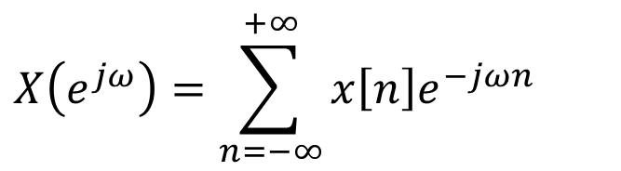
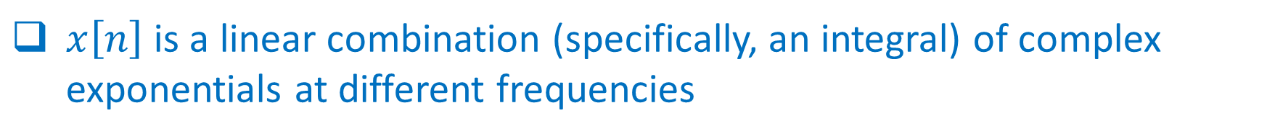
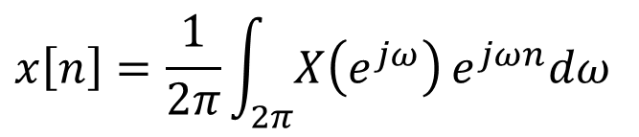
Discrete Fourier Transform
FT pairs
$$X\left(e^{jω}\right)=\sum_{n=−∞}^{+∞}{x\left[n\right]e^{−jωn}}$$
Fourier transform (FT)
$$x\left[n\right]=\frac{1}{2π}\int_{2π}^{ }{X\left(e^{jω}\right)}e^{jωn}dω$$
Inverse Fourier transform
$x\left[n\right]$is a linear combination (specifically, an integral) of complex exponentials at different frequencies
$X(e^{jω})(dω/2π)$is the weight for different frequencies
$X(e^{jω})$ is called the spectrum

Slide 5
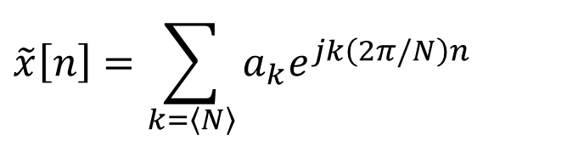

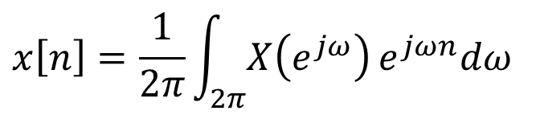
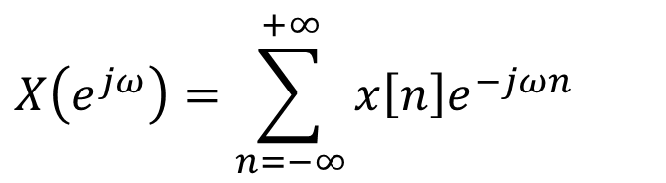
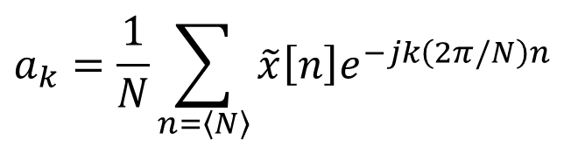
Discrete Fourier Transform
FT vs. FS
Fourier transform (FT)
Fourier series (FS)
$$x\left[n\right]=\frac{1}{2π}\int_{2π}^{ }{X\left(e^{jω}\right)}e^{jωn}dω$$
$$\tilde{x}\left[n\right]=\sum_{k=\left\langle N\right\rangle }{a_{k}e^{jk\left(2π/N\right)n}}$$
$$X\left(e^{jω}\right)=\sum_{n=−∞}^{+∞}{x\left[n\right]e^{−jωn}}$$
$$a_{k}=\frac{1}{N}\sum_{n=\left\langle N\right\rangle }{\tilde{x}\left[n\right]e^{−jk\left(2π/N\right)n}}$$
$a_{k}=\frac{1}{N}X(e^{jω})$ with $ω=k\left(2π/N\right)$

Slide 6
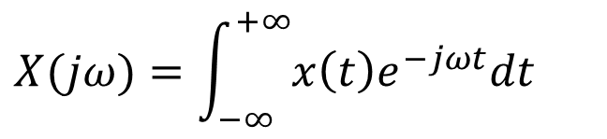

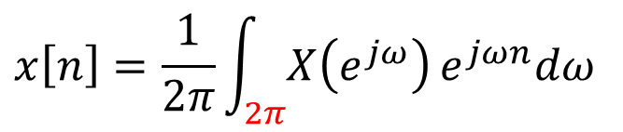

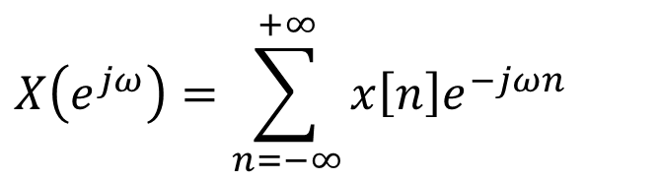


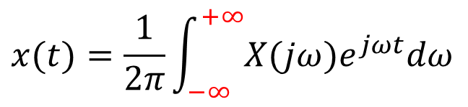

Discrete Fourier Transform
Discrete FT vs. continuous FT
Discrete FT
Continuous FT
$$x\left[n\right]=\frac{1}{2π}\int_{2π}^{ }{X\left(e^{jω}\right)}e^{jωn}dω$$
$$x(t)=\frac{1}{2π}\int_{−∞}^{+∞}{X(jω)e^{jωt}dω}$$
$$X\left(e^{jω}\right)=\sum_{n=−∞}^{+∞}{x\left[n\right]e^{−jωn}}$$
$$X(jω)=\int_{−∞}^{+∞}{x\left(t\right)e^{−jωt}dt}$$
Discrete-time complex exponentials that differ in frequency by a multiple of $2π$ are identical
$X(e^{jω})$ is periodic
Finite interval of integration in the synthesis equation for $x[n]$
$ω=0, 2π, 4π, ⋯$ $⇒$ low-frequency
$ω=π, 3π, 5π, ⋯$ $⇒$ high-frequency
Notes:
Ak is periodic with period of N. N means NW0. nw0 = 2pi.

Slide 7



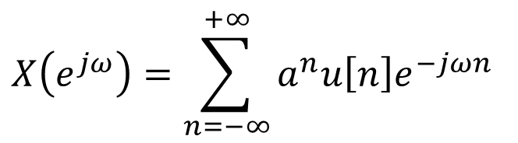



Discrete Fourier Transform
Examples
$$X\left(e^{jω}\right)=?$$
$$x\left[n\right]=a^{n}u\left[n\right], \left|a\right|<1$$
Solution
$$X\left(e^{jω}\right)=\sum_{n=−∞}^{+∞}{a^{n}u\left[n\right]e^{−jωn}}$$
$$=\sum_{n=0}^{∞}{{\left(ae^{−jω}\right)}^{n}}$$
$$=\frac{1}{1−ae^{−jω}}$$
$$a>0$$
$$a<0$$

Slide 8

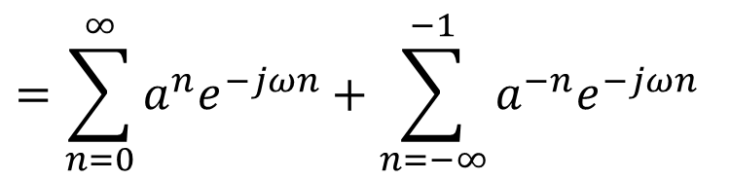
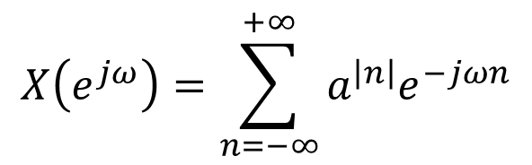

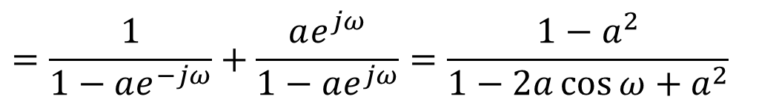
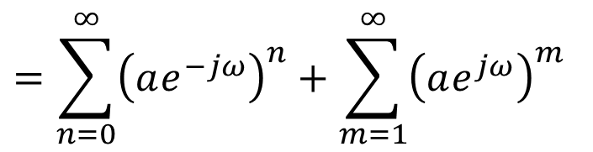
Discrete Fourier Transform
Examples
$$x\left[n\right]=a^{\left|n\right|}, \left|a\right|<1$$
$$X\left(e^{jω}\right)=?$$
Solution
$$X\left(e^{jω}\right)=\sum_{n=−∞}^{+∞}{a^{\left|n\right|}e^{−jωn}}$$
$$=\sum_{n=0}^{∞}{a^{n}e^{−jωn}}+\sum_{n=−∞}^{−1}{a^{−n}e^{−jωn}}$$
$$=\sum_{n=0}^{∞}{{\left(ae^{−jω}\right)}^{n}}+\sum_{m=1}^{∞}{{\left(ae^{jω}\right)}^{m}}$$
$$=\frac{1}{1−ae^{−jω}}+\frac{ae^{jω}}{1−ae^{jω}}=\frac{1−a^{2}}{1−2a\cos{ω}+a^{2}}$$

Slide 9
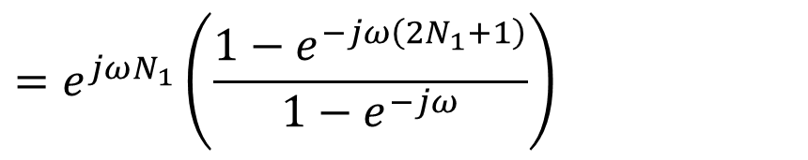

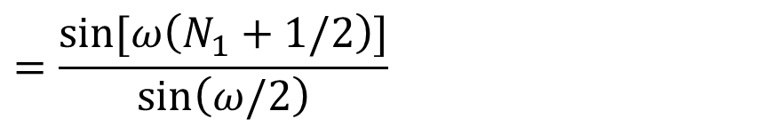
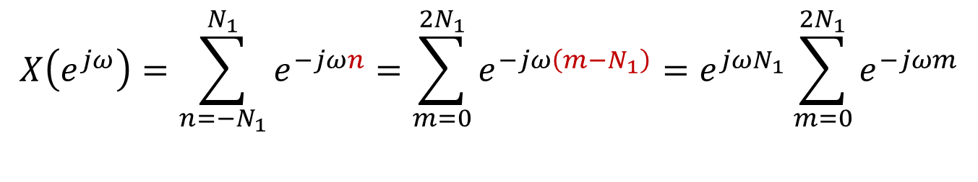
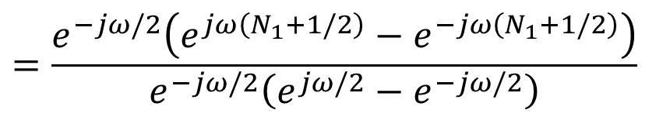
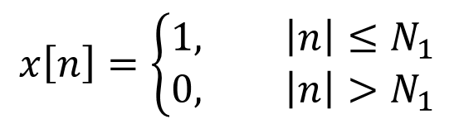

Discrete Fourier Transform
Examples
$$x\left[n\right]=\left\{\begin{aligned}1, \left|n\right|≤N_{1} \\ 0, \left|n\right|>N_{1}\end{aligned}\right.$$
$X\left(e^{jω}\right)=?$
Solution
$$X\left(e^{jω}\right)=\sum_{n=−N_{1}}^{N_{1}}{e^{−jωn}}=\sum_{m=0}^{{2N}_{1}}{e^{−jω\left(m−N_{1}\right)}}=e^{jωN_{1}}\sum_{m=0}^{{2N}_{1}}{e^{−jωm}}$$
$$N_{1}=2$$
$$=e^{jωN_{1}}\left(\frac{1−e^{−jω\left(2N_{1}+1\right)}}{1−e^{−jω}}\right)$$
$$=\frac{e^{−jω/2}\left(e^{jω\left(N_{1}+1/2\right)}−e^{−jω\left(N_{1}+1/2\right)}\right)}{e^{−jω/2}\left(e^{jω/2}−e^{−jω/2}\right)}$$
$$=\frac{\sin{[ω\left(N_{1}+1/2\right)]}}{\sin\left(ω/2\right)}$$

Slide 10
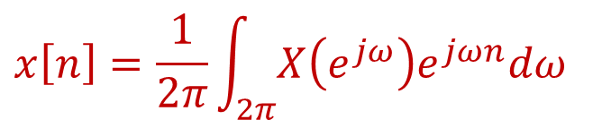
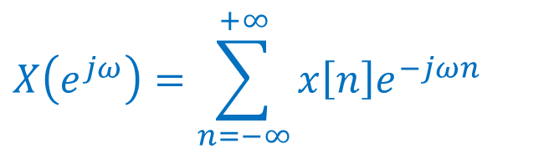
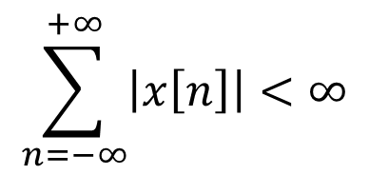
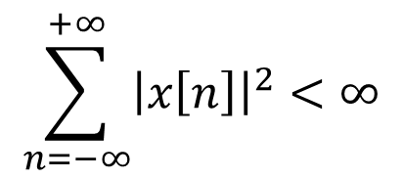
Discrete Fourier Transform
Convergence of FT
$$X\left(e^{jω}\right)=\sum_{n=−∞}^{+∞}{x\left[n\right]e^{−jωn}}$$
For the analysis equation
$$\sum_{n=−∞}^{+∞}{{\left|x\left[n\right]\right|}^{2}}<∞$$
Finite energy condition
$$\sum_{n=−∞}^{+∞}{\left|x\left[n\right]\right|}<∞$$
Absolutely summable
$$x\left[n\right]=\frac{1}{2π}\int_{2π}^{ }{X\left(e^{jω}\right)e^{jωn}dω}$$
For the synthesis equation
No convergence issues (finite interval of integration)

Slide 11

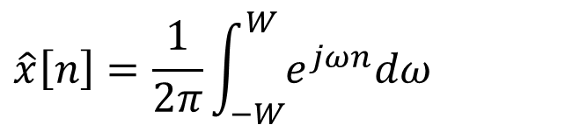

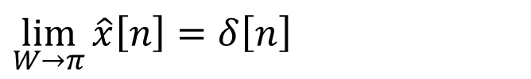
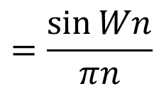
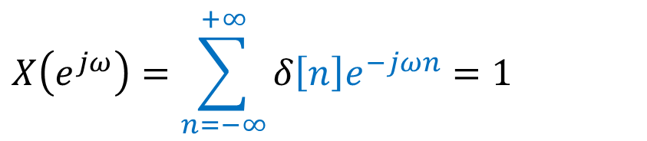
Discrete Fourier Transform
Examples
$$X\left(e^{jω}\right)=?$$
$$x\left[n\right]=δ\left[n\right]$$
$$X\left(e^{jω}\right)=\sum_{n=−∞}^{+∞}{δ\left[n\right]e^{−jωn}}=1$$
Solution 1
Solution 2
$$\hat{x}\left[n\right]=\frac{1}{2π}\int_{−W}^{W}{e^{jωn}dω}$$
$$=\frac{\sin{Wn}}{πn}$$
$$\lim_{W→π}{\hat{x}\left[n\right]}=δ\left[n\right]$$

Slide 12
The Discrete-Time Fourier Transform (ch.5)
Representation of aperiodic signals- Discrete Fourier transform
Fourier transform for periodic signals
Properties of discrete-time Fourier transform
The convolution property
The multiplication property
Duality
Systems characterized by difference equations

Slide 13
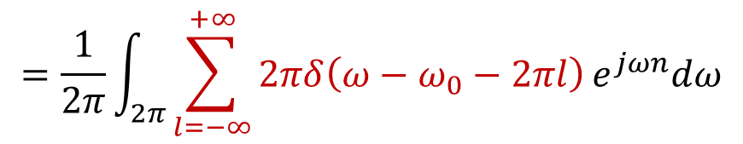
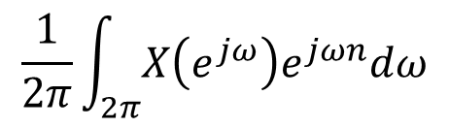

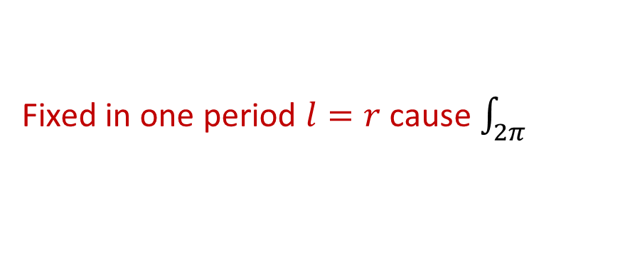

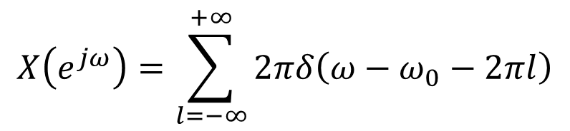

Fourier transform for periodic signals
Consider the sinusoidal signal
$$x[n]=e^{jω_{0}n}$$
The FT should be a periodic pulse train:
$$X\left(e^{jω}\right)=\sum_{l=−∞}^{+∞}{2πδ\left(ω−ω_{0}−2πl\right)}$$
Check validity: evaluate the inverse transform
$$=\frac{1}{2π}\int_{2π}^{ }{\sum_{l=−∞}^{+∞}{2πδ\left(ω−ω_{0}−2πl\right)}e^{jωn}dω}$$
$$\frac{1}{2π}\int_{2π}^{ }{X\left(e^{jω}\right)e^{jωn}dω}$$
$$=e^{j\left(ω_{0}+2πr\right)n}$$
Fixed in one period $l=r$ cause $\int_{2π}^{ }{ }$
$$=e^{jω_{0}n}$$
Notes:
The same equation as CT FT. THEN PERIODIC

Slide 14
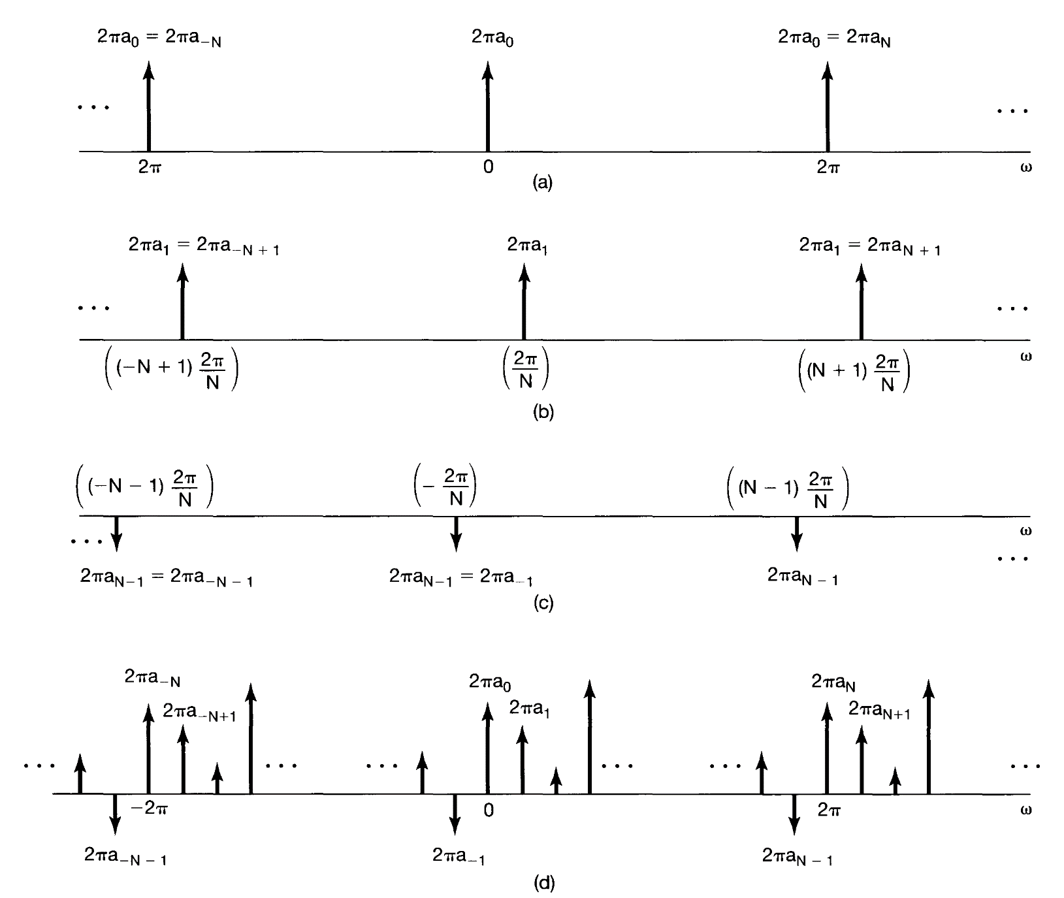



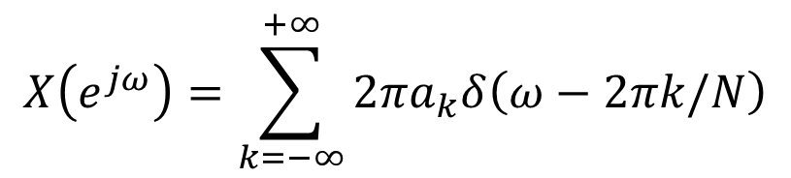

Fourier transform for periodic signals
FT of $a_{0}e^{j0\left(2π/N\right)n}$
Consider a periodic sequence
$$x\left[n\right]=\sum_{k=\left\langle N\right\rangle }{a_{k}e^{jk\left(2π/N\right)n}}$$
FT of $a_{1}e^{j\left(2π/N\right)n}$
FT
$$X\left(e^{jω}\right)=\sum_{k=−∞}^{+∞}{2πa_{k}δ\left(ω−2πk/N\right)}$$
FT of $a_{−1}e^{j−\left(2π/N\right)n}$
Verify
$$x\left[n\right]=a_{0}+a_{1}e^{j\left(2π/N\right)n}+a_{2}e^{j2\left(2π/N\right)n}$$
$+⋯+a_{N−1}e^{j\left(N−1\right)\left(2π/N\right)n}$
FT of $x[n]$

Slide 15
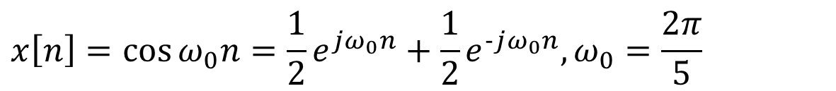
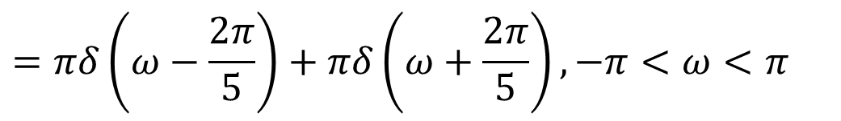
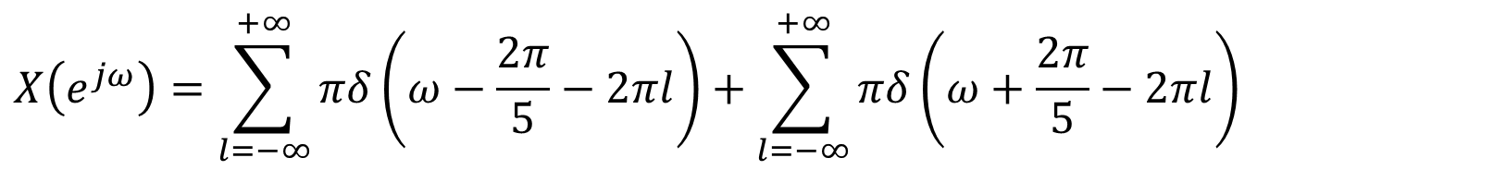

Fourier transform for periodic signals
Examples
$$x\left[n\right]=\cos{ω_{0}n}=\frac{1}{2}e^{jω_{0}n}+\frac{1}{2}e^{−jω_{0}n}, ω_{0}=\frac{2π}{5}$$
$$X\left(e^{jω}\right)=?$$
Solution
$$X\left(e^{jω}\right)=\sum_{l=−∞}^{+∞}{πδ\left(ω−\frac{2π}{5}−2πl\right)}+\sum_{l=−∞}^{+∞}{πδ\left(ω+\frac{2π}{5}−2πl\right)}$$
$$=πδ\left(ω−\frac{2π}{5}\right)+πδ\left(ω+\frac{2π}{5}\right), −π<ω<π$$

Slide 16




Fourier transform for periodic signals
Examples
$$x\left[n\right]=\sum_{k=−∞}^{+∞}{δ\left[n−kN\right]}$$
$$X\left(e^{jω}\right)=?$$
Solution
$$a_{k}=\frac{1}{N}\sum_{n=\left\langle N\right\rangle }{x\left[n\right]e^{−jk\left(2π/N\right)n}}=\frac{1}{N}$$
$$X\left(e^{jω}\right)=\frac{2π}{N}\sum_{k=−∞}^{+∞}{δ\left(ω−\frac{2πk}{N}\right)}$$

Slide 17
The Discrete-Time Fourier Transform (ch.5)
Representation of aperiodic signals- Discrete Fourier transform
Fourier transform for periodic signals
Properties of discrete-time Fourier transform
The convolution property
The multiplication property
Duality
Systems characterized by difference equations

Slide 18







Properties of discrete-time Fourier Transform
Short notation for FT pairs
$$x\left[n\right]=\frac{1}{2π}\int_{2π}^{ }{X\left(e^{jω}\right)}e^{jωn}dω$$
$$X\left(e^{jω}\right)=\sum_{n=−∞}^{+∞}{x\left[n\right]e^{−jωn}}$$
$$ℱ$$
$$x\left[n\right]$$
$$X\left(e^{jω}\right)$$
$$X\left(e^{jω}\right)=ℱ\left\{x\left[n\right]\right\}$$
$$x\left[n\right]=ℱ^{−1}\left\{X\left(e^{jω}\right)\right\}$$

Slide 19











Properties of discrete-time Fourier Transform
In contrast to continuous FT
Periodicity
$X\left(e^{j\left(ω+2π\right)}\right)=$ $X\left(e^{jω}\right)$
Linearity
$$ℱ$$
$$X_{1}\left(e^{jω}\right)$$
$$x_{1}\left[n\right]$$
$$ℱ$$
$$aX_{1}\left(e^{jω}\right)+bX_{2}\left(e^{jω}\right)$$
$$⟹$$
$ax_{1}\left[n\right]$ $+ bx_{2}\left[n\right]$
$$ℱ$$
$$x_{2}\left[n\right]$$
$$X_{2}\left(e^{jω}\right)$$

Slide 20






















Properties of discrete-time Fourier Transform
Time shifting and frequency shifting
$$ℱ$$
$$x\left[n−n_{0}\right]$$
$$e^{−jωn_{0}}X\left(e^{jω}\right)$$
$$ℱ$$
$$⟹$$
$$x\left[n\right]$$
$$X\left(e^{jω}\right)$$
$$ℱ$$
$$e^{jω_{0}n}x\left[n\right]$$
$$X\left(e^{j\left(ω−ω_{0}\right)}\right)$$
Examples
Low-pass filter $⟹$ High-pass filter
$$H_{lp}\left(e^{jω}\right)$$
$$H_{lp}\left(e^{jω}\right)$$
$$H_{hp}\left(e^{jω}\right)=H_{lp}\left(e^{j\left(ω−π\right)}\right)$$
shift by $π$
$$ℱ$$
$$⟹$$
$$ℱ$$
$$H_{hp}\left(e^{jω}\right)$$
$$=H_{lp}\left(e^{j\left(ω−π\right)}\right)$$
$$h_{lp}\left[n\right]$$
$$h_{hp}=e^{jπn}h_{lp}\left[n\right]$$
$$={\left(−1\right)}^{n}h_{lp}\left[n\right]$$

Slide 21









Properties of discrete-time Fourier Transform
Conjugation and Conjugate Symmetry
Conjugation property
$$ℱ$$
$$⟹$$
$$ℱ$$
$$x\left[n\right]$$
$$X\left(e^{jω}\right)$$
$$x^{∗}\left[n\right]$$
$$X^{∗}\left(e^{−jω}\right)$$
Conjugation Symmetry
$X\left(e^{jω}\right)=X^{∗}\left(e^{−jω}\right)$ $\left[x[n] \text{real}\right]$
$ℛe\left\{X\left(e^{jω}\right)\right\}$ is even, $ℐm\left\{X\left(e^{jω}\right)\right\}$ is odd.

Slide 22










Properties of discrete-time Fourier Transform
Time reversal
$$ℱ$$
$$ℱ$$
$$x\left[n\right]$$
$$X\left(e^{jω}\right)$$
$$⟹$$
$$x\left[−n\right]$$
$$X\left(e^{−jω}\right)$$
$x[n]$ even, $X\left(e^{jω}\right)$ even; $x[n]$ odd, $X\left(e^{jω}\right)$ odd
Recall: $x[n]$ real: $X\left(e^{jω}\right)=X^{∗}\left(e^{−jω}\right)$
$$⟹$$
$x[n]$ real and even $⟹ X\left(e^{jω}\right)$ real and even
$x[n]$ real and odd $⟹ X\left(e^{jω}\right)$ odd and purely imaginary

Slide 23
















Properties of discrete-time Fourier Transform
Time reversal
$$ℱ$$
$$ℱ$$
$$x\left[n\right]$$
$$X\left(e^{jω}\right)$$
$$⟹$$
$$x\left[−n\right]$$
$$X\left(e^{−jω}\right)$$
If $x[n]$ real
$$ℱ$$
$$ℱ\left\{x\left[n\right]\right\}=ℱ\left\{ℰv\left\{x\left[n\right]\right\}\right\}+ℱ\left\{𝒪d\left\{x\left[n\right]\right\}\right\}$$
$$ℰv\left\{x\left[n\right]\right\}$$
$$ℛe\left\{X\left(e^{jω}\right)\right\}$$
$$⟹$$
$$ℱ$$
$$=ℛe\left\{X\left(e^{jω}\right)\right\}+jℐm\left\{X\left(e^{jω}\right)\right\}$$
$$𝒪d\left\{x\left[n\right]\right\}$$
$$jℐm\left\{X\left(e^{jω}\right)\right\}$$

Slide 24









Properties of discrete-time Fourier Transform
Differencing and accumulation
$$ℱ$$
$$X\left(e^{jω}\right)$$
If
$$x\left[n\right]$$
Then
$$ℱ$$
$$x\left[n\right]−x\left[n−1\right]$$
$$(1−e^{−jω})X\left(e^{jω}\right)$$
$$\sum_{m=−∞}^{n}{x\left[m\right]}$$
$$\frac{1}{1−e^{−jω}}X\left(e^{jω}\right)+πX\left(e^{j0}\right)\sum_{k=−∞}^{+∞}{δ\left(ω−2πk\right)}$$
$$ℱ$$
DC component

Slide 25







Properties of discrete-time Fourier Transform
Differencing and accumulation
Examples
Determine FT of unit sept $x\left[n\right]=u\left[n\right]$
Solution
$$ℱ$$
$$x\left[n\right]=\sum_{m=−∞}^{n}{g\left[m\right]}$$
$$g\left[n\right]=δ\left[n\right]$$
$$G\left(e^{jω}\right)=1$$
$$X\left(e^{jω}\right)=\frac{1}{1−e^{−jω}}G\left(e^{jω}\right)+πG\left(e^{j0}\right)\sum_{k=−∞}^{+∞}{δ\left(ω−2πk\right)}$$
$$=\frac{1}{1−e^{−jω}}+π\sum_{k=−∞}^{+∞}{δ\left(ω−2πk\right)}$$

Slide 26







Properties of discrete-time Fourier Transform
Time expansion
Recall the continuous time property
$$ℱ$$
$$\frac{1}{\left|a\right|}X\left(\frac{jω}{a}\right)$$
$$x\left(at\right)$$
Try to define $x\left[an\right]$
$a$ should be an integer and $a>1$
not merely speed up, but also resample $x[n]$
Define instead
$$x_{\left(k\right)}\left[n\right]=\left\{\begin{aligned}x\left[n/k\right], \\ 0,\end{aligned}\right.$$
if $n$ is a multiple of $k$
if $n$ is not a multiple of $k$

Slide 27













Properties of discrete-time Fourier Transform
$$x_{\left(k\right)}\left[n\right]=\left\{\begin{aligned}x\left[n/k\right], \\ 0,\end{aligned}\right.$$
if $n$ is a multiple of $k$
Time expansion
if $n$ is not a multiple of $k$
$$ℱ$$
$$x\left[n\right]$$
$$X\left(e^{jω}\right)$$
$$ℱ$$
$$x_{\left(k\right)}\left[n\right]$$
$$X_{\left(k\right)}\left(e^{jω}\right)=X\left(e^{jkω}\right)$$
$$X_{\left(k\right)}\left(e^{jω}\right)=\sum_{n=−∞}^{+∞}{x_{\left(k\right)}\left[n\right]e^{−jωn}}$$
$$n=rk$$
$$=\sum_{r=−∞}^{+∞}{x_{\left(k\right)}\left[rk\right]e^{−jωrk}}$$
$$x_{\left(k\right)}\left[rk\right]=x\left[r\right]$$
$$X_{\left(k\right)}\left(e^{jω}\right)=\sum_{r=−∞}^{+∞}{x\left[r\right]e^{−j\left(kω\right)r}}=X\left(e^{jkω}\right)$$

Slide 28









Properties of discrete-time Fourier Transform
Examples
$$x\left[n\right]$$
$$X\left(e^{jω}\right)=?$$
Solution
$$x\left[n\right]=y_{\left(2\right)}\left[n\right]+2y_{\left(2\right)}\left[n−1\right]$$
$$y\left[n\right]$$
$$y\left[n\right]=\left\{\begin{matrix}1, 0≤n≤5 \\ 0, else\end{matrix}\right.$$
where
$$y_{\left(2\right)}\left[n\right]$$
$$2y_{\left(2\right)}\left[n−1\right]$$
$$y_{2}\left[n\right]=\left\{\begin{matrix}y\left[n/2\right], n is even \\ 0, n is odd\end{matrix}\right.$$

Slide 29










Properties of discrete-time Fourier Transform
Examples
$$x\left[n\right]$$
$$X\left(e^{jω}\right)=?$$
Solution
$$Y\left(e^{jω}\right)=e^{−j2ω}\frac{\sin\left(5ω/2\right)}{\sin\left(ω/2\right)}$$
$$x\left[n\right]=y_{\left(2\right)}\left[n\right]+2y_{\left(2\right)}\left[n−1\right]$$
$$y\left[n\right]$$
Using the time expansion property
$$ℱ$$
$$Y_{2}\left(e^{jω}\right)=Y\left(e^{j2ω}\right)=e^{−j4ω}\frac{\sin\left(5ω\right)}{\sin\left(ω\right)}$$
$$y_{\left(2\right)}\left[n\right]$$
$$y_{\left(2\right)}\left[n\right]$$
Using the linearity and time-shifting properties
$$ℱ$$
$$2e^{−j5ω}\frac{\sin\left(5ω\right)}{\sin\left(ω\right)}$$
$$2y_{\left(2\right)}\left[n−1\right]$$
$$2y_{\left(2\right)}\left[n−1\right]$$
$$X\left(e^{jω}\right)=e^{−j4ω}\left(1+2e^{−jω}\right)\left(\frac{\sin\left(5ω\right)}{\sin\left(ω\right)}\right)$$

Slide 30
















Properties of discrete-time Fourier Transform
$$ℱ$$
$$j\frac{dX\left(e^{jω}\right)}{dω}$$
Differentiation in frequency
Differentiation in frequency
$$nx\left[n\right]$$
Consider
$$ℱ$$
$$x\left[n\right]$$
$$X\left(e^{jω}\right)$$
$$\frac{dX\left(e^{jω}\right)}{dω}=\sum_{n=−∞}^{+∞}{−jnx\left[n\right]e^{−jωn}}$$
$$ℱ$$
$$\frac{dX\left(e^{jω}\right)}{dω}$$
$$⟹$$
$$−jnx\left[n\right]$$
$$⟹$$
$$ℱ$$
$$j\frac{dX\left(e^{jω}\right)}{dω}$$
$$nx\left[n\right]$$
Parseval’s relation
$$\sum_{n=−∞}^{+∞}{{\left|x\left[n\right]\right|}^{2}}=\frac{1}{2π}\int_{2π}^{ }{{\left|X\left(e^{jω}\right)\right|}^{2}dω}$$

Slide 31




Properties of discrete-time Fourier Transform
Examples
$$ℱ$$
$$x\left[n\right]$$
$$X\left(e^{jω}\right)$$
$x\left[n\right]$ is
Periodic?
Even?
No
No
Real?
Of finite energy?
Yes
Yes

Slide 32
The Discrete-Time Fourier Transform (ch.5)
Representation of aperiodic signals- Discrete Fourier transform
Fourier transform for periodic signals
Properties of discrete-time Fourier transform
The convolution property
The multiplication property
Duality
Systems characterized by difference equations

Slide 33






The convolution property
$$x\left[n\right]$$
$$h\left[n\right]$$
$$y[n]$$
$$ℱ$$
$$y\left[n\right]=x\left[n\right]∗h[n]$$
$$Y\left(e^{jω}\right)=X\left(e^{jω}\right)H\left(e^{jω}\right)$$
$H\left(jω\right)$: Frequency response; FT of the impulse response of the system

Slide 34














The convolution property
Examples
$$x\left[n\right]$$
$$h\left[n\right]$$
$$y[n]$$
$h\left[n\right]=δ[n−n_{0}]$ and $X\left(e^{jω}\right)=ℱ\left\{x\left[n\right]\right\}$
$$Y\left(e^{jω}\right)=?$$
Solution
$$h\left[n\right]=δ[n−n_{0}]$$
$$⟹$$
$$⟹$$
$$H\left(e^{jω}\right)=\sum_{n=−∞}^{+∞}{δ[n−n_{0}]e^{−jωn}}$$
$$y\left[n\right]=x[n−n_{0}]$$
$$=e^{−jωn_{0}}$$
$$⟹$$
$$⟹$$
$$Y\left(e^{jω}\right)=e^{−jωn_{0}}X\left(e^{jω}\right)$$

Slide 35



The convolution property
Examples
Determine the impulse response of an ideal low-pass filter
Solution
$$h\left[n\right]=\frac{1}{2π}\int_{−π}^{π}{H\left(e^{jω}\right)e^{jωn}dω}$$
$$=\frac{1}{2π}\int_{−ω_{0}}^{ω_{0}}{e^{jωn}dω}$$
NOT causal
$$=\frac{\sin{ω_{0}n}}{πn}$$

Slide 36












The convolution property
Examples
$$x\left[n\right]$$
$$h\left[n\right]$$
$$y[n]$$
$$h\left[n\right]=α^{n}u\left[n\right], \left(\left|α\right|<1\right)$$
$$x\left[n\right]=β^{n}u\left[n\right], \left(\left|β\right|<1\right)$$
$$y\left[n\right]=?$$
Solution
$$H\left(e^{jω}\right)=\frac{1}{1−αe^{−jω}}$$
$$X\left(e^{jω}\right)=\frac{1}{1−βe^{−jω}}$$
$$Y\left(e^{jω}\right)=\frac{1}{\left(1−αe^{−jω}\right)\left(1−βe^{−jω}\right)}$$
When $α≠β$
$$Y\left(e^{jω}\right)=\frac{A}{1−αe^{−jω}}−\frac{B}{1−βe^{−jω}}$$
$$B=\frac{β}{α−β}$$
$$A=\frac{α}{α−β}$$
$$y\left[n\right]=\frac{α}{α−β}α^{n}u\left[n\right]−\frac{β}{α−β}β^{n}u\left[n\right]=\frac{1}{α−β}\left(α^{n+1}u\left[n\right]−β^{n+1}u\left[n\right]\right)$$

Slide 37


The convolution property
Examples
$$x\left[n\right]$$
$$h\left[n\right]$$
$$y[n]$$
$$h\left[n\right]=α^{n}u\left[n\right],\left(\left|α\right|<1\right)$$
$$x\left[n\right]=β^{n}u\left[n\right],\left(\left|β\right|<1\right)$$
$$y\left[n\right]=?$$
Solution
$$H\left(e^{jω}\right)=\frac{1}{1−αe^{−jω}}$$
$$X\left(e^{jω}\right)=\frac{1}{1−βe^{−jω}}$$
$$Y\left(e^{jω}\right)=\frac{1}{\left(1−αe^{−jω}\right)\left(1−βe^{−jω}\right)}$$
When $α=β$
$$Y\left(e^{jω}\right)=\frac{1}{{\left(1−αe^{−jω}\right)}^{2}}=\frac{j}{α}e^{jω}\frac{d}{dω}\left(\frac{1}{1−αe^{−jω}}\right)$$
$y\left[n\right]=\left(n+1\right)α^{n}u\left[n+1\right]=$ $\left(n+1\right)α^{n}u\left[n\right]$

Slide 38








The convolution property
Examples
Consider the ideal band-stop filter,
$$Y\left(e^{jω}\right)=?$$
$$w_{1}\left[n\right]=e^{jπn}x\left[n\right]$$
$$W_{1}\left(e^{jω}\right)=X\left(e^{j\left(ω−π\right)}\right)$$
$$W_{2}\left(e^{jω}\right)=H_{lp}\left(e^{jω}\right)X\left(e^{j\left(ω−π\right)}\right)$$
$$W_{3}\left(e^{jω}\right)=W_{2}\left(e^{j\left(ω−π\right)}\right)$$
$$=H_{lp}\left(e^{j\left(ω−π\right)}\right)X\left(e^{j\left(ω−2π\right)}\right)$$
$$=H_{lp}\left(e^{j\left(ω−π\right)}\right)X\left(e^{jω}\right)$$
$$W_{4}\left(e^{jω}\right)=H_{lp}\left(e^{jω}\right)X\left(e^{jω}\right)$$
$$Y\left(e^{jω}\right)=W_{3}\left(e^{jω}\right)+W_{4}\left(e^{jω}\right)=\left[H_{lp}\left(e^{j\left(ω−π\right)}\right)+H_{lp}\left(e^{jω}\right)\right]X\left(e^{jω}\right)$$

Slide 39
The Discrete-Time Fourier Transform (ch.5)
Representation of aperiodic signals- Discrete Fourier transform
Fourier transform for periodic signals
Properties of discrete-time Fourier transform
The convolution property
The multiplication property
Duality
Systems characterized by difference equations

Slide 40








The multiplication property
$$ℱ$$
$$Y\left(e^{jω}\right)=\frac{1}{2π}\int_{2π}^{ }{X_{1}\left(e^{jθ}\right)X_{2}\left(e^{j\left(ω−θ\right)}\right)dθ}$$
$$y\left[n\right]=x_{1}\left[n\right]x_{2}\left[n\right]$$
Proof
$$Y\left(e^{jω}\right)=\sum_{n=−∞}^{+∞}{y\left[n\right]e^{−jωn}}=\sum_{n=−∞}^{+∞}{x_{1}\left[n\right]x_{2}\left[n\right]e^{−jωn}}$$
Periodic convolution
$$x_{1}\left[n\right]=\frac{1}{2π}\int_{2π}^{ }{X_{1}\left(e^{jθ}\right)e^{jθn}dθ}$$
$$Y\left(e^{jω}\right)=\sum_{n=−∞}^{+∞}{x_{2}\left[n\right]\left\{\frac{1}{2π}\int_{2π}^{ }{X_{1}\left(e^{jθ}\right)e^{jθn}dθ}\right\}e^{−jωn}}$$
$$Y\left(e^{jω}\right)=\frac{1}{2π}\int_{2π}^{ }{X_{1}\left(e^{jθ}\right)\left[\sum_{n=−∞}^{+∞}{x_{2}\left[n\right]e^{−j\left(ω−θ\right)n}}\right]dθ}$$
$$Y\left(e^{jω}\right)=\frac{1}{2π}\int_{2π}^{ }{X_{1}\left(e^{jθ}\right)X_{2}\left(e^{j\left(ω−θ\right)}\right)dθ}$$

Slide 41






The multiplication property
Examples
$$x_{1}\left[n\right]=\frac{\sin\left(πn/2\right)}{πn}$$
$$x_{2}\left[n\right]=\frac{\sin\left(3πn/4\right)}{πn}$$
$$x\left[n\right]=x_{1}\left[n\right]x_{2}\left[n\right]$$
$$X\left(e^{jω}\right)=?$$
Solution
$$X\left(e^{jω}\right)=\frac{1}{2π}\int_{−π}^{π}{X_{1}\left(e^{jω}\right)X_{2}\left(e^{j\left(ω−θ\right)}\right)dθ}$$
Convert to ordinary convolution
$${\hat{X}}_{1}\left(e^{jω}\right)=\left\{\begin{aligned}X_{1}\left(e^{jω}\right), −π<ω<π \\ 0, otherwise\end{aligned}\right.$$
Define
$$X\left(e^{jω}\right)=\frac{1}{2π}\int_{−π}^{π}{{\hat{X}}_{1}\left(e^{jθ}\right)X_{2}\left(e^{j\left(ω−θ\right)}\right)dθ}=\frac{1}{2π}\int_{−∞}^{∞}{{\hat{X}}_{1}\left(e^{jθ}\right)X_{2}\left(e^{j\left(ω−θ\right)}\right)dθ}$$

Slide 42
The Discrete-Time Fourier Transform (ch.5)
Representation of aperiodic signals- Discrete Fourier transform
Fourier transform for periodic signals
Properties of discrete-time Fourier transform
The convolution property
The multiplication property
Duality
Systems characterized by difference equations

Slide 43




























Duality
Duality in the discrete FS
Consider
$$f\left[m\right]=\frac{1}{N}\sum_{r=\left\langle N\right\rangle }{g\left[r\right]e^{−jr\left(2π/N\right)m}}$$
$$f\left[m\right] and g\left[r\right] are periodic$$
$$m=k, r=n$$
$$⟹$$
$$⟹$$
$$m=n, r=−k$$
$$f\left[k\right]=\frac{1}{N}\sum_{n=\left\langle N\right\rangle }{g\left[n\right]e^{−jk\left(2π/N\right)n}}$$
$$f\left[n\right]=\frac{1}{N}\sum_{k=\left\langle N\right\rangle }{g\left[−k\right]e^{jk\left(2π/N\right)n}}$$
$$⟹$$
$$⟹$$
$$ℱ𝒮$$
$$ℱ𝒮$$
$$\frac{1}{N}g[−k]$$
g$\left[n\right]$
$$f[k]$$
$$f\left[n\right]$$
Every property of the discrete FS has a dual.
Examples
$$\sum_{r=\left\langle N\right\rangle }{x\left[r\right]y\left[n−r\right]}$$
$$ℱ𝒮$$
$$ℱ𝒮$$
$$Na_{k}b_{k}$$
$$x\left[n−n_{0}\right]$$
$$a_{k}e^{−jk\left(2π/N\right)n_{0}}$$
$$ℱ𝒮$$
$$\sum_{l=\left\langle N\right\rangle }{a_{l}b_{k−l}}$$
$$ℱ𝒮$$
$$x\left[n\right]y\left[n\right]$$
$$e^{jm\left(2π/N\right)n}x\left[n\right]$$
$$a_{k−m}$$

Slide 44







Duality
Examples
$$x\left[n\right]=\left\{\begin{matrix}\frac{1}{9}\frac{\sin{(5πn/9)}}{\sin{(πn/9)}}, & n≠multiple of 9 \\ 5/9, & n=multiple of 9\end{matrix}\right.$$
$$a_{k}=?$$
①Dual in the frequency domain: $n→k$
$$b_{k}=\left\{\begin{matrix}\frac{1}{9}\frac{\sin{(5πk/9)}}{\sin{(πk/9)}}, & k≠multiple of 9 \\ 5/9, & k=multiple of 9\end{matrix}\right.$$
②Time domain signal
$$ℱS$$
$$g\left[n\right]$$
$$b_{k}$$

Slide 45


Duality
Examples
$$x\left[n\right]=\left\{\begin{matrix}\frac{1}{9}\frac{\sin{(5πn/9)}}{\sin{(πn/9)}}, & n≠multiple of 9 \\ 5/9, & n=multiple of 9\end{matrix}\right.$$
$$a_{k}=?$$
$$ℱS$$
$$\left\{\begin{matrix}\frac{1}{N}\frac{\sin\left[2πk(N_{1}+1/2)/N\right]}{\sin{(πk/N)}}, & k≠0, ±N,±2N, ⋯ \\ \left(2N_{1}+1\right)/N, & k=0, ±N,±2N, ⋯\end{matrix}\right.$$

Slide 46



Duality
Examples
$$x\left[n\right]=\left\{\begin{matrix}\frac{1}{9}\frac{\sin{(5πn/9)}}{\sin{(πn/9)}}, & n≠multiple of 9 \\ 5/9, & n=multiple of 9\end{matrix}\right.$$
$$a_{k}=\frac{1}{N}g\left[−k\right]=\left\{\begin{matrix}1/9, & \left|k\right|≤2 \\ 0, & 2<\left|k\right|≤4\end{matrix}\right.$$
$$a_{k}=?$$
③Duality
①Dual in the frequency domain: $n→k$
$$b_{k}=\left\{\begin{matrix}\frac{1}{9}\frac{\sin{(5πk/9)}}{\sin{(πk/9)}}, & k≠multiple of 9 \\ 5/9, & k=multiple of 9\end{matrix}\right.$$
$$g\left[n\right]=\left\{\begin{matrix}1, & \left|n\right|≤2 \\ 0, & 2<\left|n\right|≤4\end{matrix}\right.$$
②Time domain signal
$$ℱS$$
$$g\left[n\right]$$
$$b_{k}$$
g$\left[n\right] is periodic (N=9)$

Slide 47





Duality
Duality between discrete FT and continuous FS
$$X\left(e^{jω}\right)=\sum_{n=−∞}^{+∞}{x\left[n\right]e^{−jωn}}$$
$$x\left[n\right]=\frac{1}{2π}\int_{2π}^{ }{X\left(e^{jω}\right)e^{jωn}dω}$$
Discrete FT
$n→{kω}_{0}$, $ω→−t$
$$x\left(t\right)=\sum_{k=−∞}^{+∞}{a_{k}e^{jkω_{0}t}}$$
$$a_{k}=\frac{1}{T}\int_{T}^{ }{x\left(t\right)e^{−jkω_{0}t}dt}$$
Continuous FS

Slide 48










Properties of discrete-time Fourier Transform
$$x\left[n\right]=\frac{\sin{(πn/2)}}{πn}$$
Examples
$$X\left(e^{jω}\right)=?$$
① DT $→$ CT FS: $n→{kω}_{0}$
$$a_{k}=\frac{\sin{(kω_{0}π/2)}}{{kω}_{0}π}$$
③Duality: $\frac{1}{N}g\left[−k\right]$?
$$ω_{0}=1$$
$$g\left(t\right)=\left\{\begin{matrix}1, & \left|t\right|≤T_{1} (T_{1}=π/2) \\ 0, & T_{1}<\left|t\right|≤T\end{matrix}\right.$$
$$ℱ𝒮$$
$$a_{k}=\frac{\sin\left({kω}_{0}T_{1}\right)}{kπ}, k≠0$$
②CT signal

Slide 49










Properties of discrete-time Fourier Transform
$$x\left[n\right]=\frac{\sin{(πn/2)}}{πn}$$
Examples
$$X\left(e^{jω}\right)=?$$
① DT $→$ CT FS: $n→{kω}_{0}$
$$g\left(t\right)=\left\{\begin{matrix}1, & \left|t\right|≤T_{1} (T_{1}=π/2) \\ 0, & T_{1}<\left|t\right|≤T\end{matrix}\right.$$
$$ℱ𝒮$$
$$a_{k}=\frac{\sin{(kπ/2)}}{kπ}$$
②CT signal
$$ω_{0}=1$$
$$\frac{\sin\left(πk/2\right)}{πk}=\frac{1}{T}\int_{T}{g\left(t\right)e^{−jkt}dt}=\frac{1}{2π}\int_{−π/2}^{π/2}{g\left(t\right)e^{−jkt}dt}$$
$$n=kω_{0}, t=ω$$
$$\frac{\sin\left(πn/2\right)}{πn}=\frac{1}{2π}\int_{−π/2}^{π/2}{g\left(ω\right)e^{−jωn}dω}$$
$$\frac{\sin\left(πn/2\right)}{πn}=\frac{1}{2π}\int_{−π/2}^{π/2}{g\left(ω\right)e^{jωn}dω}$$
$$X\left(e^{jω}\right)=g\left(ω\right)=\left\{\begin{matrix}1, & \left|ω\right|≤π/2 \\ 0, & π/2<\left|ω\right|≤π\end{matrix}\right.$$
$$∴$$

Slide 50
Duality
Summary FS and FT expressions

Slide 51
The Discrete-Time Fourier Transform (ch.5)
Representation of aperiodic signals- Discrete Fourier transform
Fourier transform for periodic signals
Properties of discrete-time Fourier transform
The convolution property
The multiplication property
Duality
Systems characterized by difference equations

Slide 52



System characterized by difference equations
$$\sum_{k=0}^{N}{a_{k}y\left[n−k\right]}=\sum_{k=0}^{M}{b_{k}x\left[n−k\right]}$$
$$\sum_{k=0}^{N}{a_{k}e^{−jkω}Y\left(e^{jω}\right)}=\sum_{k=0}^{M}{b_{k}e^{−jkω}X\left(e^{jω}\right)}$$
$$H\left(e^{jω}\right)=\frac{Y\left(e^{jω}\right)}{X\left(e^{jω}\right)}=\frac{\sum_{k=0}^{M}{b_{k}e^{−jkω}}}{\sum_{k=0}^{N}{a_{k}e^{−jkω}}}$$

Slide 53




System characterized by difference equations
Causal LTI system
Examples
$$y\left[n\right]−ay\left[n−1\right]=x\left[n\right], \left|a\right|<1$$
$$h\left[n\right]=?$$
Solution
$$H\left(e^{jω}\right)=\frac{1}{1−ae^{−jω}}$$
$$h\left[n\right]=a^{n}u\left[n\right]$$

Slide 54






System characterized by difference equations
Causal LTI system
Examples
$$y\left[n\right]−\frac{3}{4}y\left[n−1\right]+\frac{1}{8}y\left[n−2\right]=2x\left[n\right]$$
$$h\left[n\right]=?$$
Solution
$$H\left(e^{jω}\right)=\frac{2}{1−\frac{3}{4}e^{−jω}+\frac{1}{8}e^{−j2ω}}$$
$$=\frac{2}{\left(1−\frac{1}{2}e^{−jω}\right)\left(1−\frac{1}{4}e^{−jω}\right)}$$
$$=\frac{4}{1−\frac{1}{2}e^{−jω}}−\frac{2}{1−\frac{1}{4}e^{−jω}}$$
$$h\left[n\right]=4{\left(\frac{1}{2}\right)}^{n}u\left[n\right]−2{\left(\frac{1}{4}\right)}^{n}u\left[n\right]$$

Slide 55





System characterized by difference equations
Causal LTI system
Examples
$$y\left[n\right]−\frac{3}{4}y\left[n−1\right]+\frac{1}{8}y\left[n−2\right]=2x\left[n\right]$$
$$x\left[n\right]={\left(\frac{1}{4}\right)}^{n}u\left[n\right]$$
$$y\left[n\right]=?$$
Solution
$$Y\left(e^{jω}\right)=H\left(e^{jω}\right)X\left(e^{jω}\right)=\left[\frac{2}{\left(1−\frac{1}{2}e^{−jω}\right)\left(1−\frac{1}{4}e^{−jω}\right)}\right]\left[\frac{1}{1−\frac{1}{4}e^{−jω}}\right]$$
$$=\frac{2}{\left(1−\frac{1}{2}e^{−jω}\right){\left(1−\frac{1}{4}e^{−jω}\right)}^{2}}=−\frac{4}{1−\frac{1}{4}e^{−jω}}−\frac{2}{{\left(1−\frac{1}{4}e^{−jω}\right)}^{2}}+\frac{8}{1−\frac{1}{2}e^{−jω}}$$
$$y\left[n\right]=\left\{−4{\left(\frac{1}{4}\right)}^{n}−2\left(n+1\right){\left(\frac{1}{4}\right)}^{n}+8{\left(\frac{1}{2}\right)}^{n}\right\}u[n]$$

